Slide 1
Distributed Systems
Token based: Singhal’s Heuristic Algorithm
by
Ms. Neha Shukla
(B.Tech, M.Tech, Ph.D*)
CSE Department
KIET Group of Institutions

Slide 2
Contents
Token based: Singhal’s Heuristic Algorithm

Slide 3
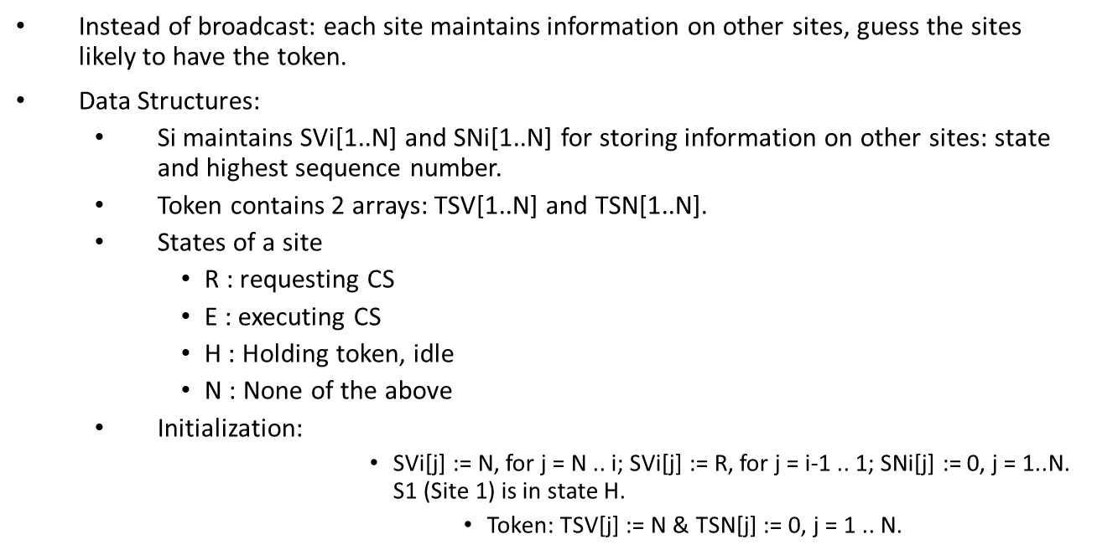

Slide 4
Requesting CS
  If Si has no token and requests CS:
    SVi[i] := R. SNi[i] := SNi[i] + 1.
    Send REQUEST(i,sn) to sites Sj for which SVi[j] = R. (sn: sequence number, updated value of SNi[i]).
  Receiving REQUEST(i,sn): if sn <= SNj[i], ignore. Otherwise, update SNj[i] and do:
    SVj[j] = N -> SVj[i] := R.
    SVj[j] = R -> If SVj[i] != R, set it to R & send REQUEST(j,SNj[j]) to Si. Else do nothing.
    SVj[j] = E -> SVj[i] := R.
    SVj[j] = H -> SVj[i] := R, TSV[i] := R, TSN[i] := sn, SVj[j] = N. Send token to Si.
      Executing CS: after getting token. Set SVi[i] := E.

Slide 5
Releasing CS
  SVi[i] := N, TSV[i] := N. Then, do:
    For other Sj: if (SNi[j] > TSN[j]), then {TSV[j] := SVi[j]; TSN[j] := SNi[j]}
    else {SVi[j] := TSV[j]; SNi[j] := TSN[j]}
  If SVi[j] = N, for all j, then set SVi[i] := H. Else send token to a site Sj provided SVi[j] = R.
Fairness of algorithm will depend on choice of Si, since no queue is maintained in token.
Arbitration rules to ensure fairness used.
Performance
  Low to moderate loads: average of N/2 messages.
  High loads: N messages (all sites request CS).
  Synchronization delay: T.

Slide 6
Thank
You

